Slide 1
Big Data & Analytics

Slide 2
Hadoop is an open-source framework designed for processing and analyzing large datasets (big data) in a parallel and distributed manner across a cluster of computers. This parallel world unlocks incredible possibilities for tackling massive amounts of information that would overwhelm traditional single-machine systems.

Slide 3
Dividing and Conquering
Imagine a vast ocean of data. Hadoop doesn’t attempt to swim through it all at once. Instead, it divides the data into smaller, manageable chunks called data blocks. These blocks are distributed across multiple computers in the cluster, each acting as a tiny island processing its own portion.

Slide 4
Hadoop’s Parallel World
- Hadoop processes large datasets in parallel across multiple nodes.
The two critical components of Hadoop are
- Uses HDFS (Hadoop Distributed File System) for storage.
- MapReduce processes data efficiently.
- Examples:
- Social Media Analytics: Facebook uses Hadoop to analyze user interactions.
- Financial Risk Analysis: Banks use Hadoop for fraud detection and risk management.

Slide 5
MapReduce.
Because Hadoop stores the entire dataset in small pieces across a collection of servers, analytical jobs can be distributed, in parallel, to each of the servers storing part of the data.
Each server evaluates the question against its local fragment simultaneously and reports its results back for collation into a comprehensive answer.
MapReduce is the agent that distributes the work and collects the results.

Slide 6
Both HDFS and MapReduce are designed to continue to work in the face of system failures. HDFS continually monitors the data stored on the cluster.
If a server becomes unavailable, a disk drive fails, or data is damaged, whether due to hardware or software problems, HDFS automatically restores the data from one of the known good replicas stored elsewhere on the cluster.
Likewise, when an analysis job is running, MapReduce monitors progress of each of the servers participating in the job.
If one of them is slow in returning an answer or fails before completing its work, MapReduce automatically starts another instance of that task on another server that has a copy of the data.
Because of the way that HDFS and MapReduce work, Hadoop provides scalable, reliable, and fault-tolerant services for data storage and analysis at very low cost.

Slide 7
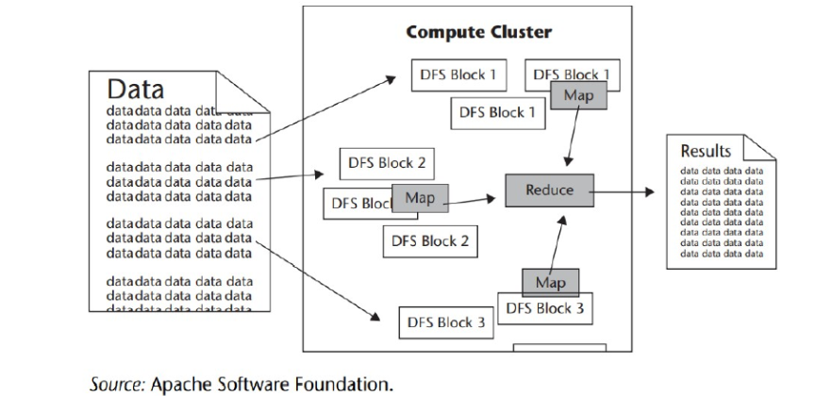

Slide 8
Old vs. New Approaches
The old way is a data and analytics technology stack with different layers “cross-communicating data” and working on “scale-up” expensive hardware.
The new way is a data and analytics platform that does all the data processing and analytics in one “layer,” without moving data back and forth on cheap but scalable (“scale out”) commodity hardware.
The new approach is based on two foundational concepts. Number one, data needs to be stored in a system in which the hardware is infinitely scalable.
In other words, you cannot allow hardware (storage and network) to become the bottleneck. Number two, data must be processed, and converted into usable business intelligence where it sits.

Slide 9
The three main important points are
1.The technology stack has changed. New proprietary technologies and open-source inventions enable different approaches that make it easier and more affordable to store, manage, and analyze data.
2. Hardware and storage is affordable and continuing to get cheaper to enable massive parallel processing.
3. The variety of data is on the rise and the ability to handle unstructured data is on the rise

Slide 10
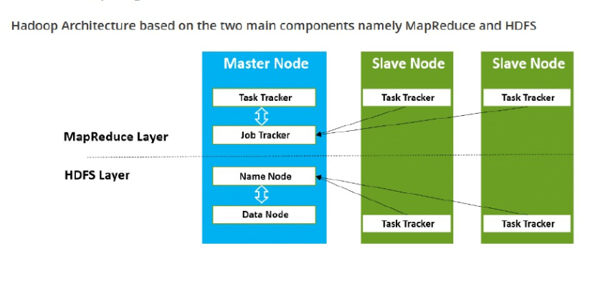
Hadoop High Level Architecture

Slide 11
The Apache Hadoop Module
Hadoop Common:Includes the common utilities which supports the other Hadoop modules
HDFS: Hadoop Distributed File System provides unrestricted, high-speed access to the data application.
Hadoop YARN: This technology is basically used for scheduling of job and efficient management of the cluster resource.
MapReduce: This is a highly efficient methodology for parallel processing of huge volumes of data

Slide 12
The Hadoop Distributed File System (HDFS).
HDFS is the storage system for a Hadoop cluster. When data lands in the
cluster, HDFS breaks it into pieces and distributes those pieces among
the different servers participating in the cluster. Each server stores just a
small fragment of the complete data set, and each piece of data is
replicated on more than one server.

Slide 13
MapReduce
Hadoop relies on a two-step approach called MapReduce:
Map Phase: Each computer (node) runs a “map” function on its assigned data block. This function transforms the data into key-value pairs, where the key identifies a specific grouping and the value represents the data associated with that group.
Reduce Phase: The key-value pairs from all nodes are shuffled and sorted based on their keys, ensuring all values belonging to the same group are sent to the same node. Each node then runs a “reduce” function on its group of values, performing aggregations or summaries.

Slide 14
Parallel Processing Powerhouse
The magic lies in the parallelism. While traditional systems process data sequentially, one record at a time, Hadoop harnesses the collective power of the entire cluster. Multiple nodes simultaneously process their data blocks, significantly speeding up the overall processing time

Slide 15
Benefits of Hadoop’s Parallel World
Scalability: Can handle massive datasets efficiently by distributing the workload across multiple nodes.
Fault Tolerance: Resilient to failures. If a node crashes, its work is simply reassigned to other nodes.
Cost-effective: Leverages commodity hardware, making it a cost-effective solution.
Simple Programming Model: Focuses on map and reduce functions, simplifying parallelization.

Slide 16
Beyond MapReduce
While MapReduce is a core concept, Hadoop has evolved to offer other processing models like Spark and Flink, providing more flexibility and real-time capabilities.

Slide 17
Data Discovery
- Identifying patterns and insights from raw data.
- Uses data visualization tools like Tableau, Power BI.
- Helps in decision-making and business strategy.
- Examples:
- Retail Industry: Walmart uses data discovery to optimize inventory.
- Healthcare: Hospitals analyze patient data to detect disease patterns.

Slide 18
Open-Source Technology for Big Data Analytics
The open-source projects are managed and supported by
commercial companies, such as Cloudera, that provide extra capabilities, training, and professional services that support open- source projects such as Hadoop.
This is similar to what Red Hat has done for the open-source project Linux.
The advantage of the open source stack—flexibility, extensibility, and lower cost
“One of the great benefits of open source lies in the flexibility of the adoption model: you download and deploy it when you need it,” . With open source, you can try it and adopt it at your own pace.

Slide 19
The several assumptions of big data are
1.The amounts of data generated would be manageable
2. Programming resources would remain scarce
3. Faster data processing would require bigger, more expensive hardware “One of the great benefits of open source lies in the flexibility of the adoption model: you download and deploy it when you need it,” .
With open source, you can try it and adopt it at your own pace.
The several assumptions of big data are
1.The amounts of data generated would be manageable
2. Programming resources would remain scarce
3. Faster data processing would require bigger, more expensive hardware

Slide 20
Open Source Technology for Big Data Analytics
- Popular tools:
- Apache Spark – Fast data processing.
- Hadoop – Scalable storage & computing.
- Elasticsearch – Real-time search & analytics.
- Cost-effective and community-driven.
- Examples:
- Netflix: Uses Apache Spark for movie recommendations.
- NASA: Uses Elasticsearch for real-time space mission analytics.

Slide 21
cloud and Big Data
Cloud computing is the use of computing resources (hardware and software) that are delivered as a service over a network (typically the Internet).
It’s a virtualization framework. It is like a resource on demand whether it be storage, computing etc. Cloud follows pay per usage model. You need to pay the amount of resource you use.
This computing service by cloud charges you based only on the amount of computing resources we use.
So for example, if you want to give demo to a client on a cluster of more than 100 machines and you do not have so many machines currently available with you, then in such case cloud computing plays a very important role.
Cloud plays an important role within the Big Data world, by providing horizontally expandable and optimized infrastructure that supports practical implementation of Big Data.
In cloud computing, all data is gathered in data centers and then distributed to the end-users. Further, automatic backups and recovery of data is also ensured for business continuity, all such resources are available in the cloud.
We do not know exact physical location of these resources provided to us. You just need dummy terminals like desktops, laptops, phones etc. and a net connection

Slide 22
There are multiple ways to access the cloud:
1. Applications or software as a service (SAAS) ex. Salesforce.com, dropbox, google drive etc.
2. Platform as a service (PAAS)
3. Infrastructure as a service (IAAS)

Slide 23
Features of Cloud Computing
Let us see few features of cloud computing:
a. Scalability:Scalability is provided by using distributed computing
b. Elasticity:Customers are allowed to use and pay for only that much resource which it is using.
In cloud computing, elasticity is defined as the degree to which a system is able to adapt to workload changes in an autonomic manner, so that at any time the available resources match the current demand as closely as possible.
c. Resource Pooling :Same resources are allowed to be used by multiple organizations. The computing resources are pooled for serving various consumers via multi-tenant model, with different resources dynamically assigned and reassigned according to consumer demand.
d. Self service Customers are provided easy to use interface through which they can choose services they want. A consumer can unilaterally provision computing capabilities, such as server time and network storage, as needed without requiring human interaction.

Slide 24
e. Low Costs It charges you based only on the amount of computing resources we use and you need not buy expensive infrastructure. Pricing on a utility computing basis is usage-based and fewer IT skills are required for implementation.
f. Fault Tolerance:Allows recovery in case of a part in cloud system fails to respond.

Slide 25
Cloud Deployment Models
There are mainly 2 types of cloud deployments models:
Public cloud – A cloud is called a “public cloud” when the services are open over a network for public use.
Private Cloud – Private cloud is operated solely for a single organization, whether managed internally or by a third-party, and hosted either internally or externally.

Slide 26
Cloud Delivery Models
Cloud services are categorized as below:
1. Infrastructure as a service (IAAS): It means complete infrastructure will be provided to you. Maintenance related tasks will be done by cloud provider and you can use it as per your requirement. It can be used as public and private both.
Examples of IaaS are virtual machines, load balancers, and network attached storage.
2. Platform as a service (PAAS): Here we have object storage, queuing, databases, runtime etc. All these we can get directly from the cloud provider. It’s our responsibility to configure and use that. Providers will give us the resources but connectivity to our database and other similar activities are our responsibility.
Examples of PaaS are Windows Azure and Google App Engine (GAE).
3. Applications or software as a service (SAAS) ex. Salesforce.com, dropbox,google drive etc. Here we do not have any responsibility. We are using the application that is running on the cloud. All infrastructure setup is the responsibility of the service provider. For SaaS to work, the infrastructure (IaaS) and the platform (PaaS) must be in place.

Slide 27
Cloud for Big Data
Below are some examples of how cloud applications are used for Big Data:
IAAS in a public cloud:Using a cloud provider’s infrastructure for Big Data services, gives access to almost limitless storage and compute power.
IaaS can be utilized by enterprise customers to create cost-effective and easily scalable IT solutions where cloud providers bear the complexities and expenses of managing the underlying hardware.
If the scale of a business customer’s operations fluctuates, or they are looking to expand, they can tap into the cloud resource as and when they need it rather than purchase, install and integrate hardware themselves.

Slide 28
PAAS in a private cloud:PaaS vendors are beginning to incorporate Big Data technologies such as Hadoop and MapReduce into their PaaS offerings, which eliminate the dealing with the complexities of managing individual software and hardware elements.
For example, web developers can use individual PaaS environments at every stage of development, testing and ultimately hosting their websites.
However, businesses that are developing their own internal software can also utilize Platform as a Service, particularly to create distinct ring-fenced development and testing environments

Slide 29
SAAS in a hybrid cloud: Many organizations feel the need to analyze the customer’s voice, especially on social media. SaaS vendors provide the platform for the analysis as well as the social media data.
Office software is the best example of businesses utilizing SaaS. Tasks related to accounting, sales, invoicing, and planning can all be performed through SAAS. Businesses may wish to use one piece of software that performs all of these tasks or several that each performs different tasks.
The software can be subscribed through the internet and then accessed online via any computer in the office using a username and password. If needed, they can switch to software that fulfills their requirements in better manner.
Everyone who needs access to a particular piece of software can be set up as a user, whether it is one or two people or every employee in a corporation that employs hundreds

Slide 30
Cloud and Big Data
- Cloud computing enables scalable and flexible Big Data storage.
- Major platforms:
- AWS (Amazon Web Services)
- Google Cloud Platform
- Microsoft Azure
- Reduces infrastructure costs and improves accessibility.
- Examples:
- Spotify: Uses Google Cloud to store and process music streaming data.
- Airbnb: Uses AWS for scalable property listing management.

Slide 31
Predictive Analytics
- Uses historical data to predict future trends.
- Techniques: Machine Learning, Statistical Models.
- Applications:
- Fraud Detection: Credit card companies use AI to detect suspicious transactions.
- Healthcare Diagnosis: IBM Watson predicts disease outbreaks using patient records.
- Customer Behavior Analysis: Amazon predicts purchasing trends for personalized recommendations.

Slide 32
Data Discovery: Work the Way People ’s Minds Work
There is a lot of buzz in the industry about data discovery, the term used to describe the new wave of business intelligence that enables users to explore data, make discoveries, and uncover insights in a dynamic and intuitive way versus predefined queries and preconfigured drill-down dashboards.
Tableau Software and QlikTech are the two Business intelligence tools used for reporting .
Analytics and reporting are produced by the people using the results. IT provides the infrastructure, but business people create their own reports and dashboards.
There is a simple example of powerful visualization that the Tableau team is referring to. A company uses an interactive dashboard to track the critical metrics driving their business.

Slide 33
Every day, the CEO and other executives are plugged in real-time to see how their markets are performing in terms of sales and profit, what the service quality scores look like against advertising investments, and how products are performing in terms of revenue and profit. Interactivity is key: a click on any filter lets the executive look into specific markets or products.
She can click on any data point in any one view to show the related data in the other views. Hovering over a data point lets her winnow into any unusual pattern or outlier by showing details on demand.

Slide 34
This is a prime example of the way people ’s minds work.
Qliktech has designed a way for users to leverage direct— and
indirect—search. With QlikView search, users type relevant words or phrases in any order and get instant, associative results.
With a global search bar, users can search across the entire data set. With search boxes on individual list boxes, users can confi ne the search to just that field.
Users can conduct both direct and indirect searches. For example, if a user wanted to identify a sales rep but couldn’t remember the sales rep ’s name—just details about the person, such as that he sells fish to customers in the Nordic region.

Slide 35
Mobile Business Intelligence Is Going Mainstream
The definition of mobile BI refers to the access and use of information via mobile devices. With the increasing use of mobile devices for business – not only in management positions – mobile BI is able to bring business intelligence and analytics closer to the user when done properly. Whether during a train journey, in the airport departure lounge or during a meeting break, information can be consumed almost anywhere and anytime with mobile BI.
Mobile BI – driven by the success of mobile devices – was considered by many as a big wave in BI and analytics a few years ago.
Nowadays, there is a level of disillusion in the market and users attach much less importance to this trend.

Slide 36
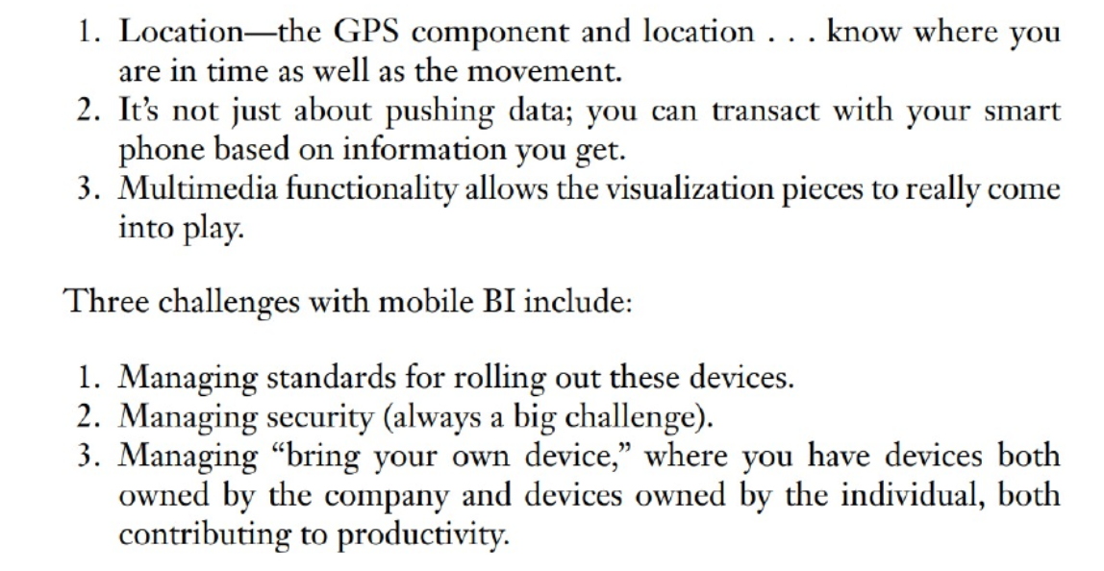
Ease of Mobile Application Deployment
Three elements that have impacted the viability of mobile BI:

Slide 37
Mobile Business Intelligence & Big Data
- Access analytics on mobile devices.
- Real-time data insights for businesses.
- Examples:
- Google Analytics on mobile: Provides real-time website traffic insights.
- Salesforce Mobile: Helps sales teams track customer interactions.
- Uber: Uses mobile BI to track ride demand and optimize pricing.

Slide 38
Conclusion
- Big Data revolutionizes decision-making and business strategies.
- Open-source tools and cloud make analytics affordable and scalable.
- Predictive analytics and mobile BI are the future trends.

